Slide 1
Statistical Natural Language Processing Project Summary General language understanding evaluation using many variants of BERT model
Members: Nguyen Xuan Binh, Nguyen Long
Professor: Mikko Kurimo
School of Science
Aalto University

Slide 2
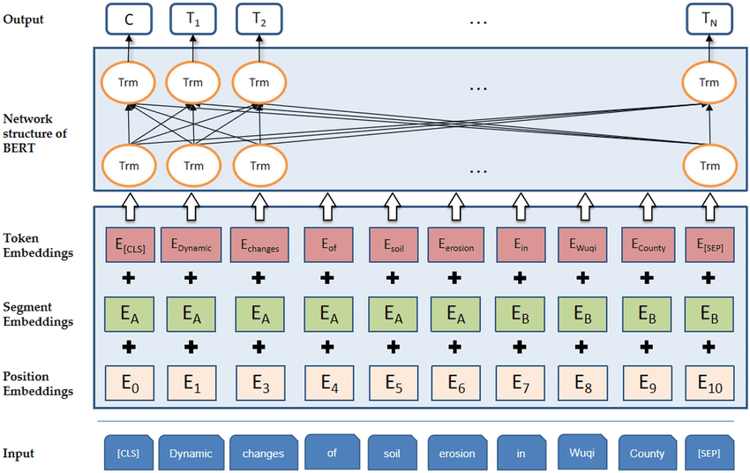
Introduction
BERT has become a significant topic in the Deep Learning community since 2018
BERT enables the use of vast amounts of unannotated text for pre-training general-purpose language models, which can then be fine-tuned on smaller, specific datasets.
The core idea of BERT is bidirectional training using Masked Language Modelling (MLM) and next sentence prediction (NSP)
BERT’s architecture relies on the transformer model, focusing only on the encoder part.
Input for BERT includes token, segment, and positional embeddings to distinguish different sentences and their order.
Notes:
BERT has become a significant topic in the Deep Learning community since its introduction by Google AI Language in late 2018. This model leverages vast amounts of unannotated text to pre-train general-purpose language models, which can then be fine-tuned on smaller, specific datasets. The core idea of BERT lies in enhancing language understanding through the bidirectional training of the transformer model, which considers both left and right context simultaneously using the Masked LM technique (MLM). Moreover, BERT’s architecture is built upon the transformer model, focusing exclusively on the encoder part. To process input effectively, BERT incorporates token, segment, and positional embeddings, which help distinguish between different sentences and their order in the text.

Slide 3
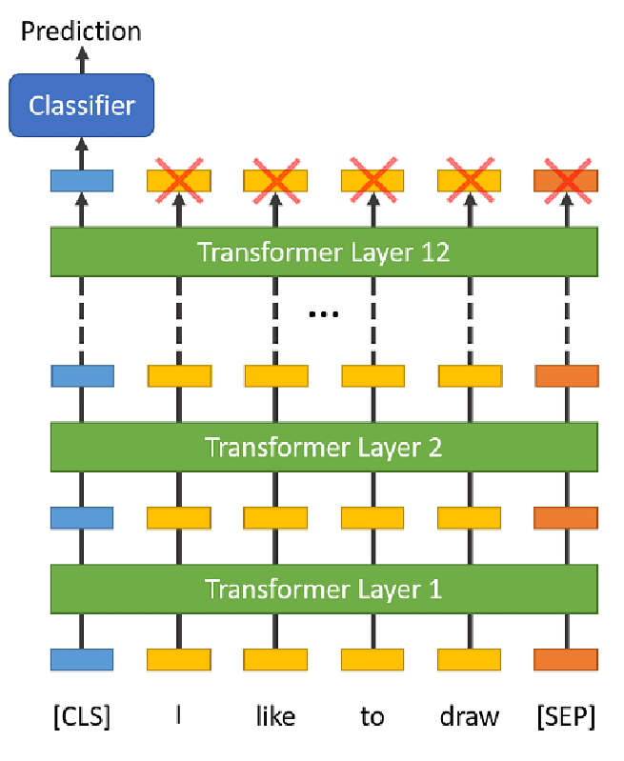
Project goal: Fine-tuning BERT for sequence classification
PROJECT GOAL: fine-tuning BERT to classify sentences based on the General Language Understanding Evaluation benchmark, particularly the QQP and SST-2 datasets
Classification layer
A simple neural network layer (often just a linear layer) is added on top of the BERT model. This layer takes the output from the [CLS] token as input.
The linear layer maps the [CLS] token’s representation to the number of classes in the specific task (2 for binary)
Fine-tuning: The entire model, including BERT’s parameters and the newly added classification layer, is fine-tuned on a labeled QQP and SST-2. Initial weights of BERT are adjusted slightly to adapt to the classification task.
Class prediction: The class with the highest softmax probability is selected as the predicted class for the input sequence.
Notes:
The project goal is to fine-tune BERT for sentence classification based on the General Language Understanding Evaluation benchmark, focusing specifically on the QQP and SST-2 datasets. To achieve this, a simple neural network layer, often just a linear layer, is added on top of the BERT model. This classification layer uses the output from the [CLS] token as input, mapping the [CLS] token's representation to the number of classes required for the specific task, which is 2 for binary classification. During fine-tuning, the entire model—including BERT’s parameters and the newly added classification layer—is adjusted on a labeled QQP and SST-2 dataset. The initial weights of BERT are slightly modified to adapt to the classification task effectively. Finally, class prediction is made by selecting the class with the highest softmax probability as the predicted class for the input sequence.

Slide 4
Two datasets: QQP and SST-2
Quora Question Pair Dataset (QQP)
Task: Determine if these two questions for each datapoint are duplicates of each other (1) or not (0)
Stanford Sentiment Treebank binary (SST-2)
Task: Determine the sentiment of the movie review whether it is good (1) or bad (0)
id qid1 qid2 question1 question2 is_duplicate
133273 213221 213222 How is the life of a math student? Could you describe your own experiences? Which level of prepration is enough for the exam jlpt5? 0
402555 536040 536041 How do I control my horny emotions? How do you control your horniness? 1
150662 155721 7256 What can one do after MBBS? What do i do after my MBBS ? 1
183004 279958 279959 Where can I find a power outlet for my laptop at Melbourne Airport? Would a second airport in Sydney, Australia be needed if a high-speed rail link was created between Melbourne and Sydney? 0
sentence label
hide new secretions from the parental units 0
contains no wit , only labored gags 0
that loves its characters and communicates something rather beautiful about human nature 1
remains utterly satisfied to remain the same throughout 0
on the worst revenge-of-the-nerds clichés the filmmakers could dredge up 0
demonstrates that the director of such hollywood blockbusters as patriot games can still turn out a small , personal film with an emotional wallop . 1
of saucy 1
Notes:
In this slide, we're looking at two datasets used for sentence classification with BERT models: the Quora Question Pair Dataset (QQP) and the Stanford Sentiment Treebank binary (SST-2). For the QQP task, we aim to determine whether pairs of questions are duplicates, indicating a '1' for yes and '0' for no. On the other hand, the SST-2 task involves sentiment analysis of movie reviews, where the model predicts if a review is positive, marked as '1', or negative, indicated by '0'.

Slide 5

BERT and Its Variants: Benchmarking performance of BERT variants
BERT base uncased
12-layer,
768-hidden size,
12-heads,
110M parameters.
BERT variants
BERT
RoBERTa
DistilBERT
ALBERT
DeBERTa
DeBERTa base
12 layers
768-hidden size
12-heads: 12
110M parameters
RoBERTa base
12-layers
768-hidden size
12-heads
125M parameters
ALBERT base
12 repeating layers
128 embedding,
768-hidden,
12-heads,
11M parameters
DistilBERT based uncased
6-layers
768-hidden size
12-heads
66M parameters

Slide 6
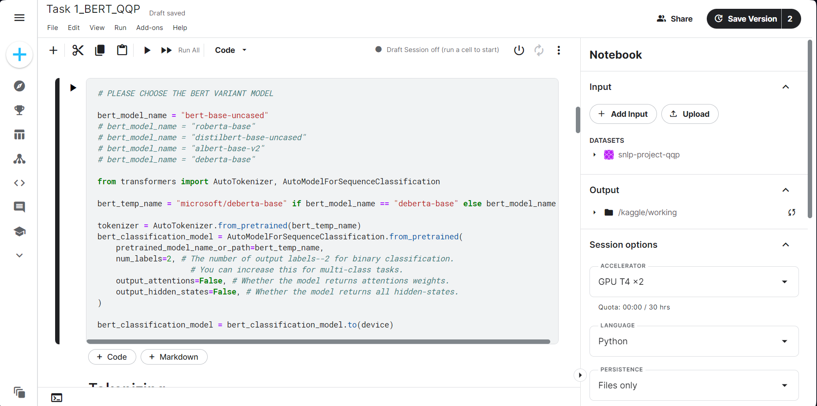
Experiment Setup

Slide 7
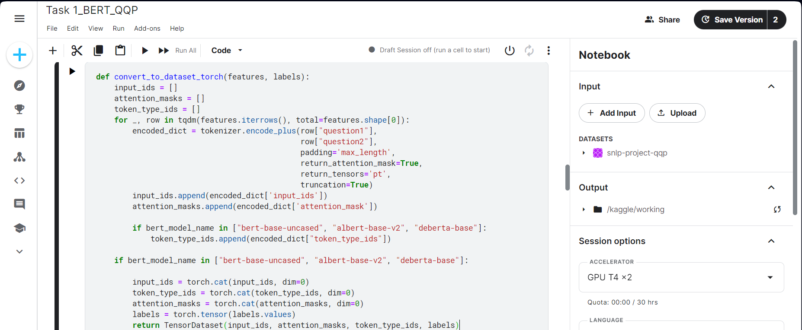
Experiment Setup

Slide 8
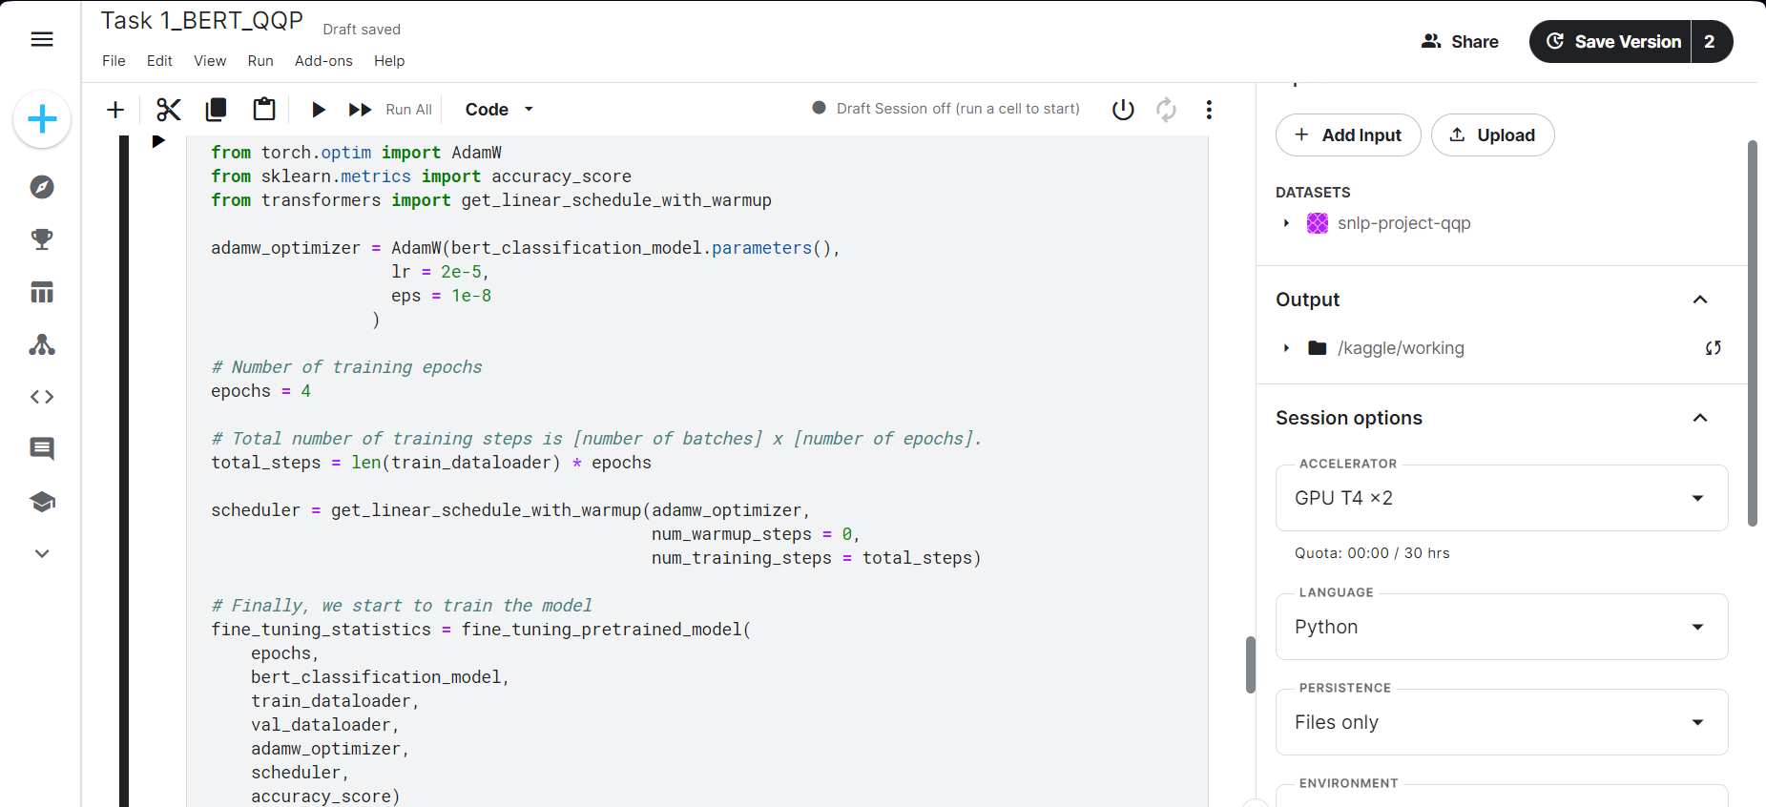
Experiment Setup

Slide 9
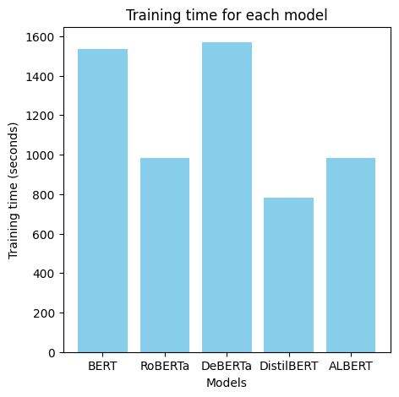
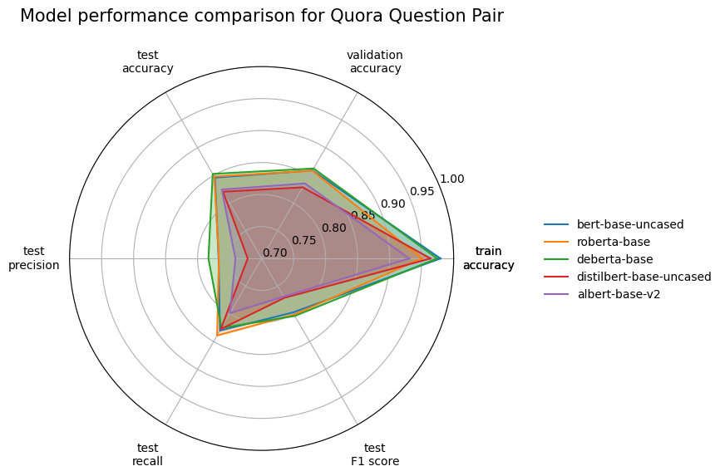
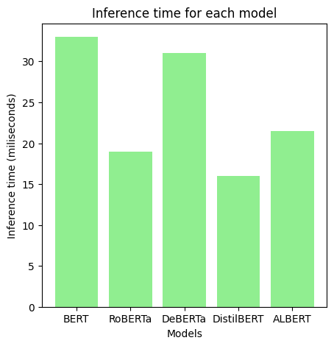
Results from QQP

Slide 10
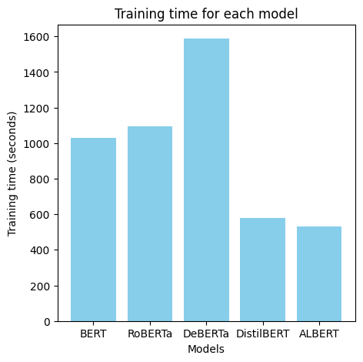
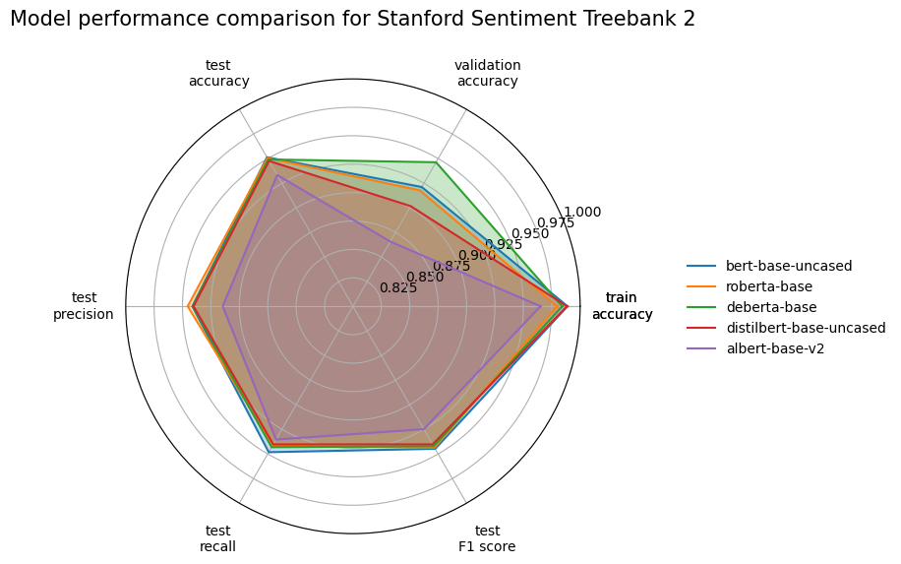
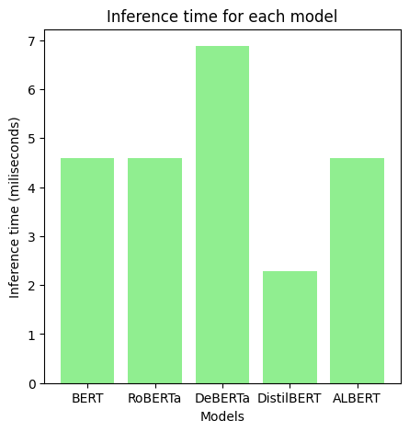
Results from SST-2

Slide 11
Discussions
1. RoBERTa and DeBERTa, shows robust performance across the tasks (QQP and SST-2)
2. Larger models like DeBERTa showed slightly better accuracy and F1 scores
3. Smaller models like DistilBERT and ALBERT, despite having fewer parameters, still maintained competitive performance
4. The study confirmed that all BERT variants have strong generalization capabilities across different NLP tasks, which is crucial for practical applications. However, specific task performance still varies
Future directions: experimenting with different pre-training datasets or fine-tuning techniques could further improve model performance and efficiency .
Notes:
The BERT variants, particularly RoBERTa and DeBERTa, shows robust performance across the tasks (QQP and SST-2), outperforming traditional BERT in several metrics, including precision and recall.
Impact of Model Size and Efficiency: Larger models like DeBERTa showed slightly better accuracy and F1 scores, indicating a trade-off between model size and computational efficiency. Smaller models like DistilBERT and ALBERT, despite having fewer parameters, still maintained competitive performance, emphasizing their suitability for resource-constrained environments .
Generalization Ability: The study confirmed that all BERT variants have strong generalization capabilities across different NLP tasks, which is crucial for practical applications. However, specific task performance still varies, suggesting room for optimization in model training or architecture adjustments.
Future Directions: The findings advocate for further research into hybrid models that might combine the strengths of each BERT variant. Additionally, experimenting with different pre-training datasets or fine-tuning techniques could further enhance model performance and efficiency .

Slide 12
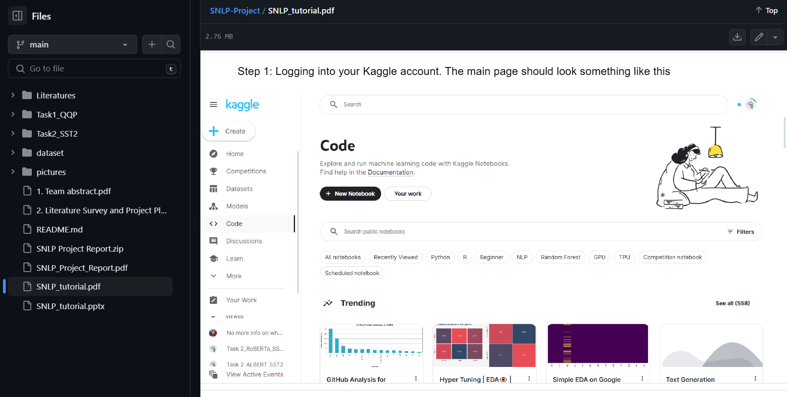
Available tutorial for training the BERT models

Slide 13


Contact info
binh.nguyen@aalto.fi
Notes:
BERT is a really powerful language representation model that has been a big milestone in the field of NLP — it has greatly increased our capacity to do transfer learning in NLP; it comes with the great promise to solve a wide variety of NLP tasks.

